Slide 1
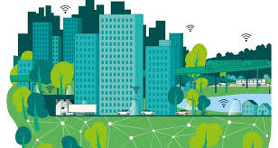

ESE Group 6
NETWORKED TRAFFIC CONTROL IN SMART CITY
ESE GROUP 6
Arjun Veeramony
Angel Mary
Swathi Chandrashekaraiah
Vipin Krishna Vijayakumar
Akhilesh Kakkayamkode

Slide 2
Contents
Introduction
Requirements
Use Case Diagram
Activity & Sequence Diagram for Dynamic Rerouting on Traffic Congestion
Activity & Sequence Diagram for Pedestrian Crossing
Activity & Sequence Diagram for Networked Traffic Control in an Accident Scenario
Block Diagram
Internal Block Diagram
Parametric Constraint Diagram
State Machine Diagram
Task Scheduling
Implementation Testing
Hazards & How to overcome it?

Slide 3
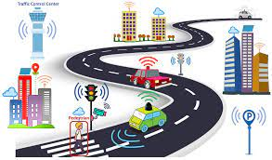
Introduction
Networked traffic control is revolutionizing transportation for autonomous vehicles.
Leveraging real-time data and communication technologies, it dynamically redirects traffic to alleviate congestion.
For pedestrians,the system dynamically adapt signal and signal timings, it ensures seamless crossings with safety.
This system integrates real-time communication and data analytics to dynamically manage traffic during emergencies.

Slide 4
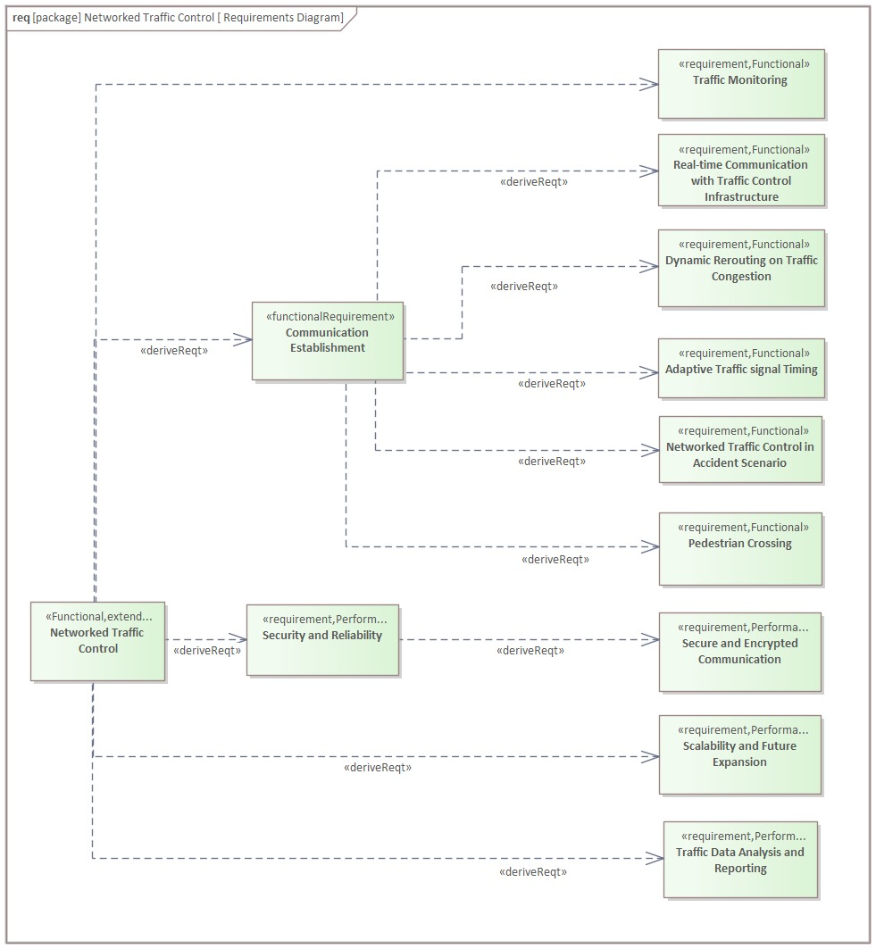
2. Requirements
Diagram

Slide 5
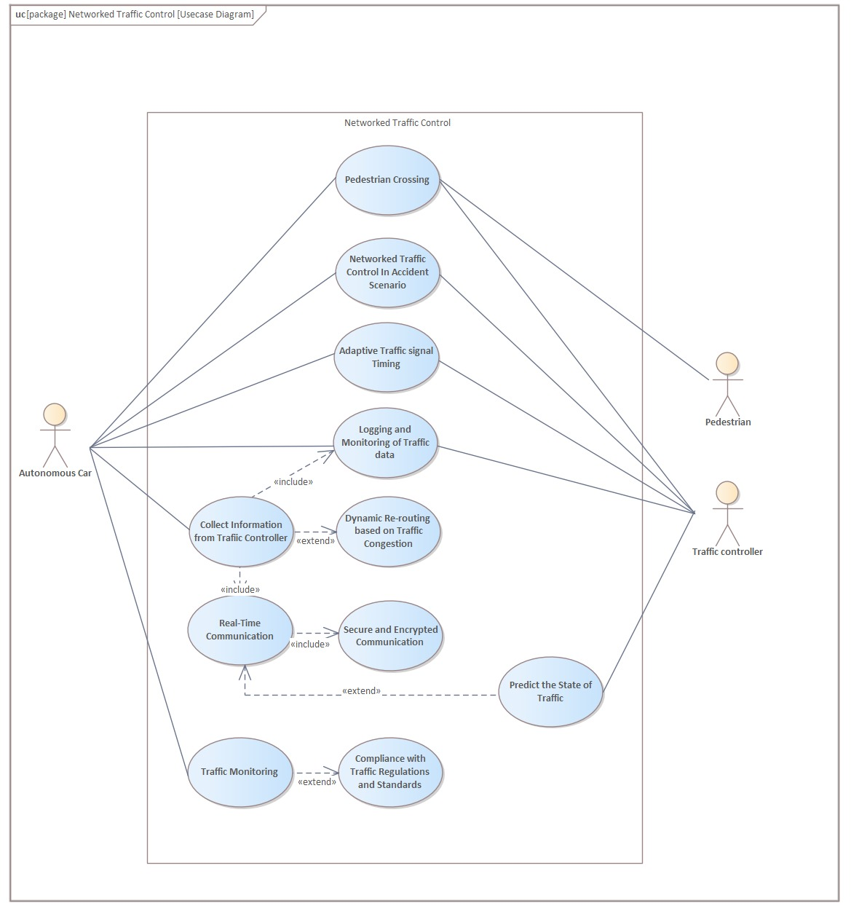
3. Use Case Diagram

Slide 6
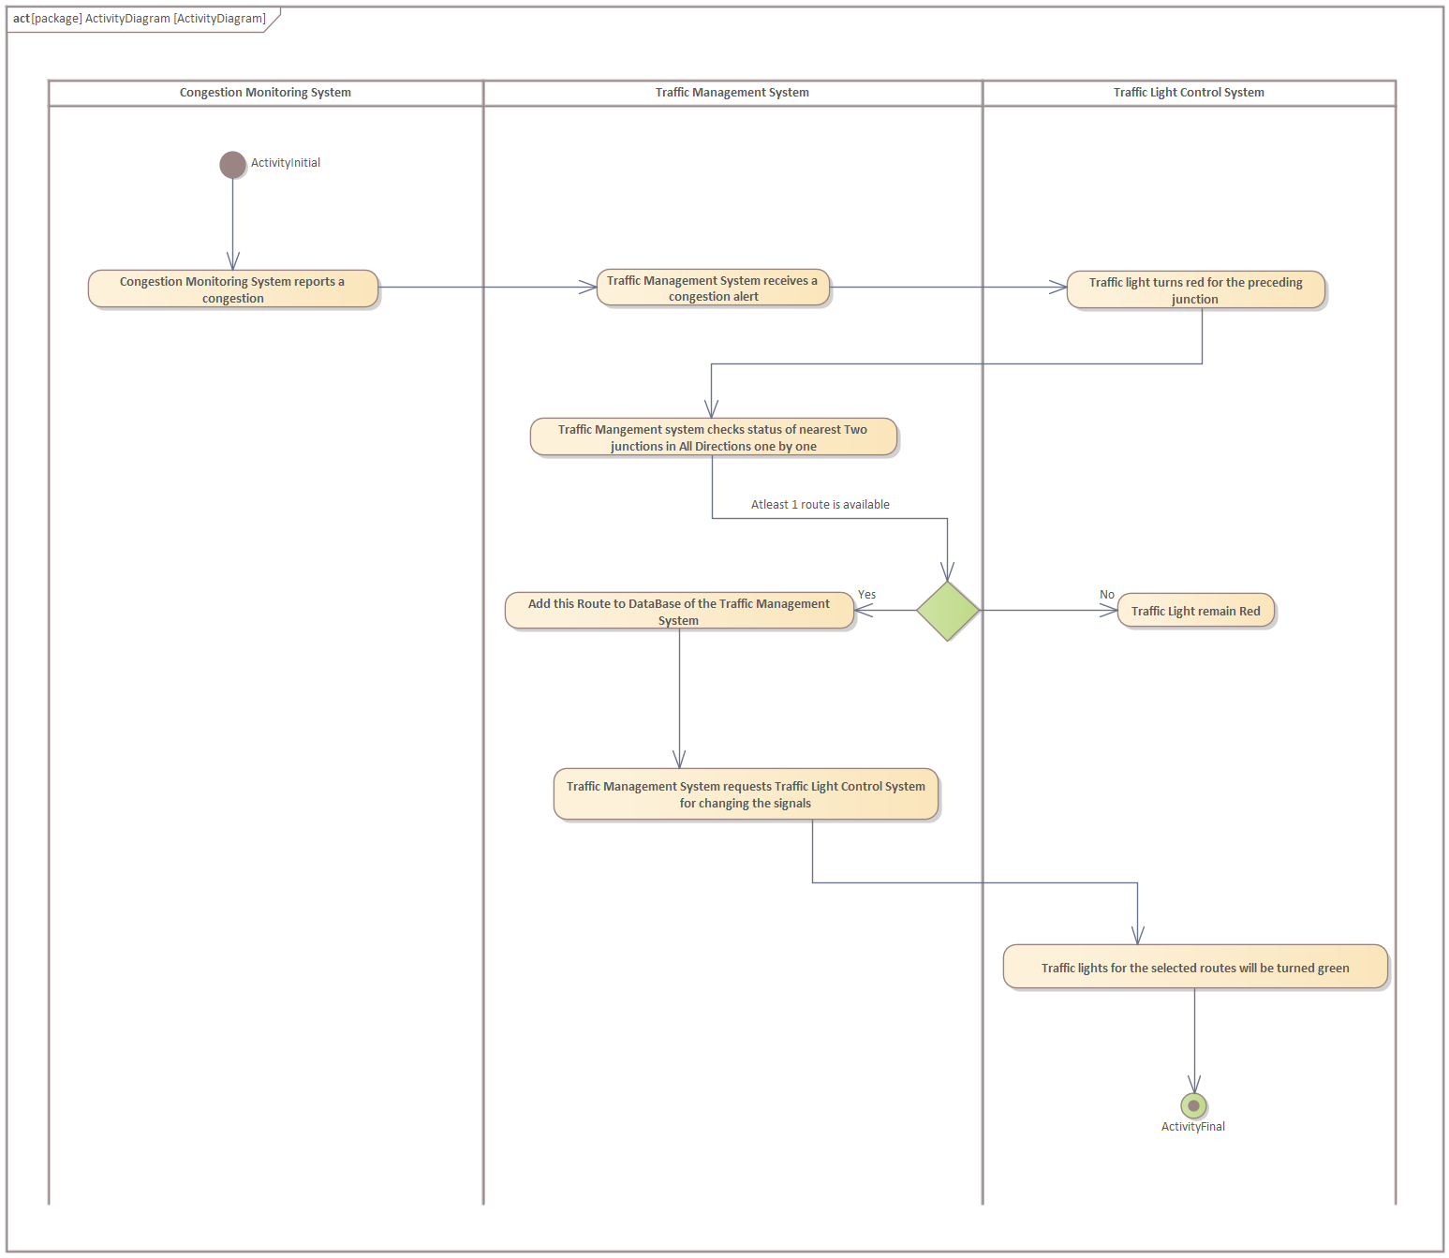
4. Activity Diagram for Dynamic Rerouting on Traffic congestion

Slide 7
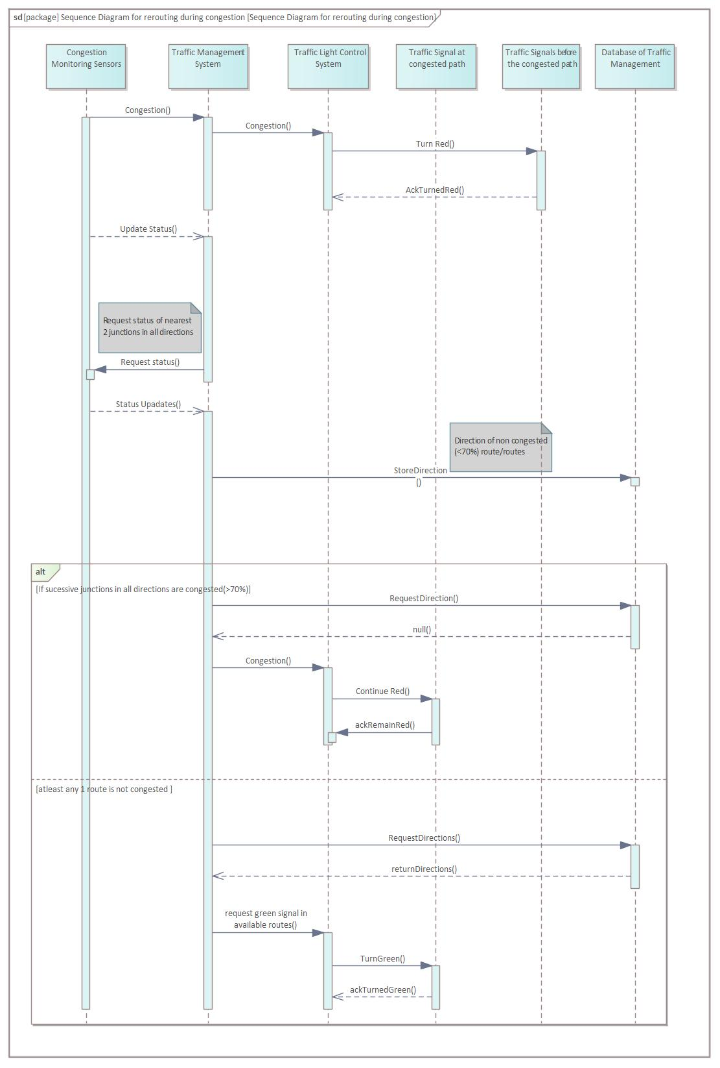
Sequence Diagram for
Dynamic Rerouting on
Traffic congestion

Slide 8
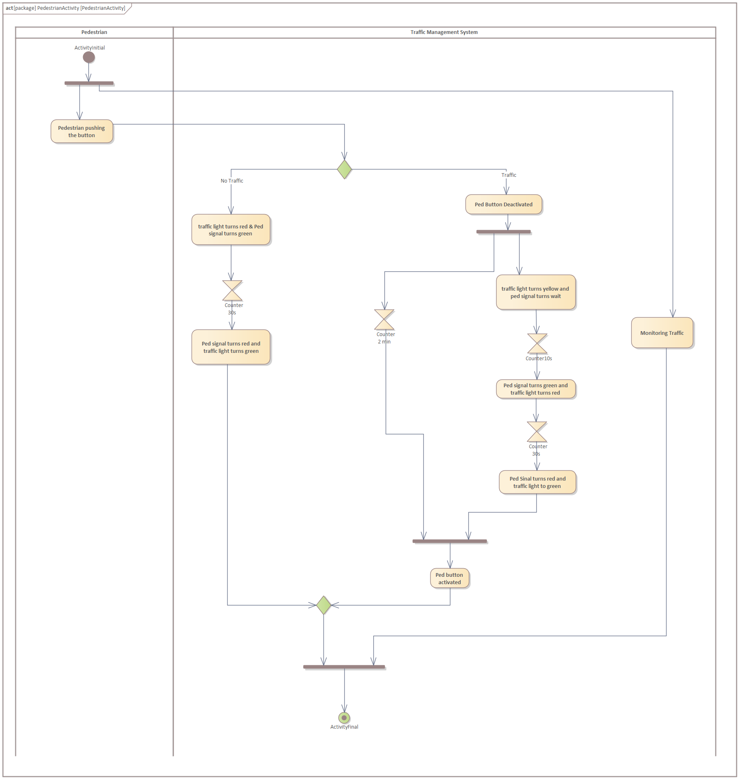
5. Activity Diagram for Pedestrian Crossing

Slide 9
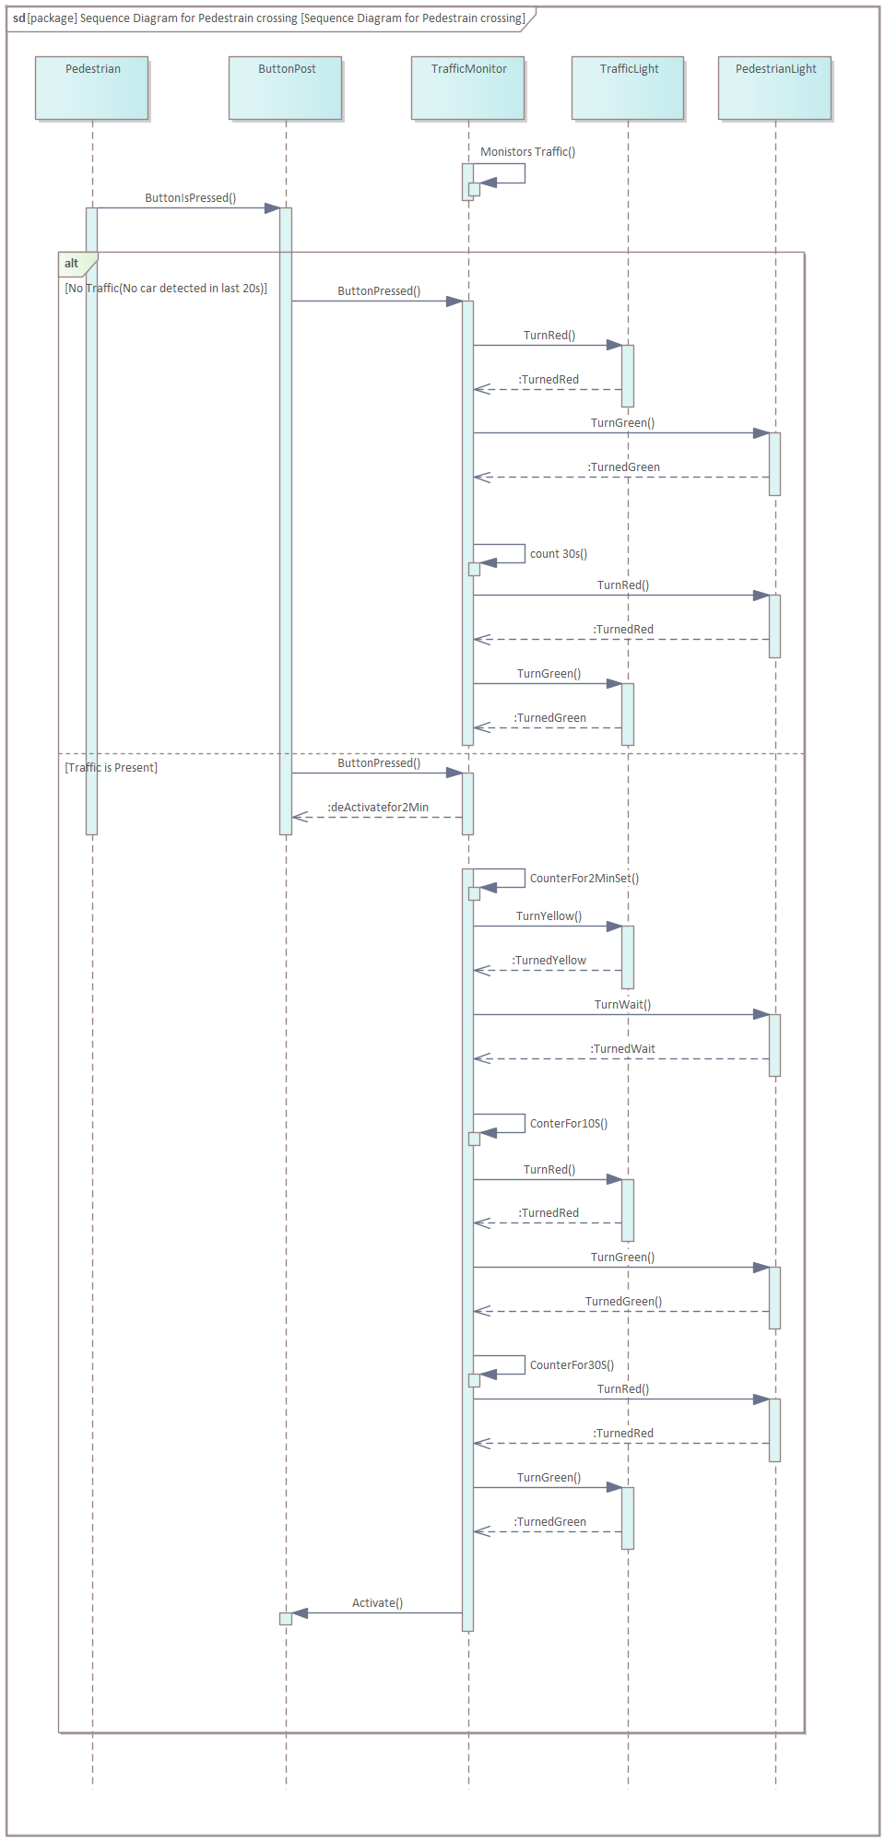
Sequence Diagram for Pedestrian Crossing

Slide 10
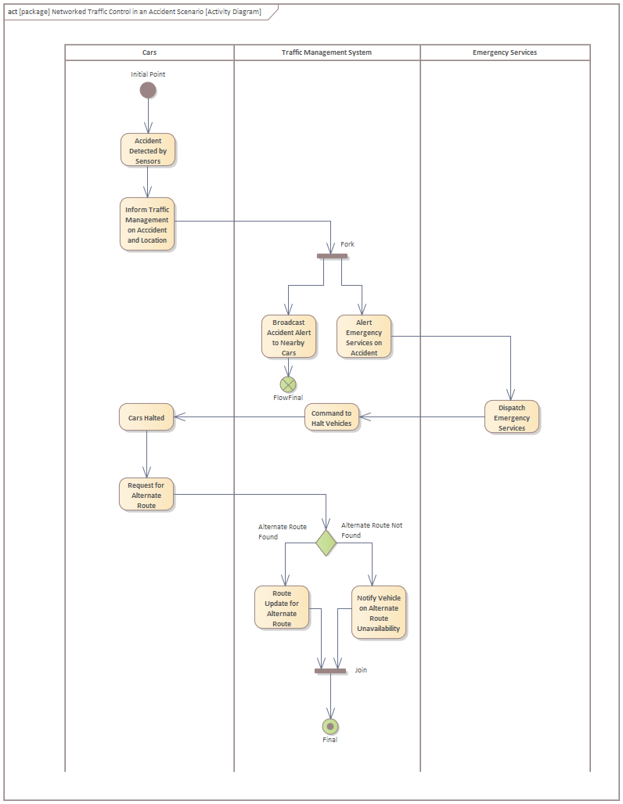
6. Activity Diagram for Networked Traffic Control in an Accident Scenario

Slide 11
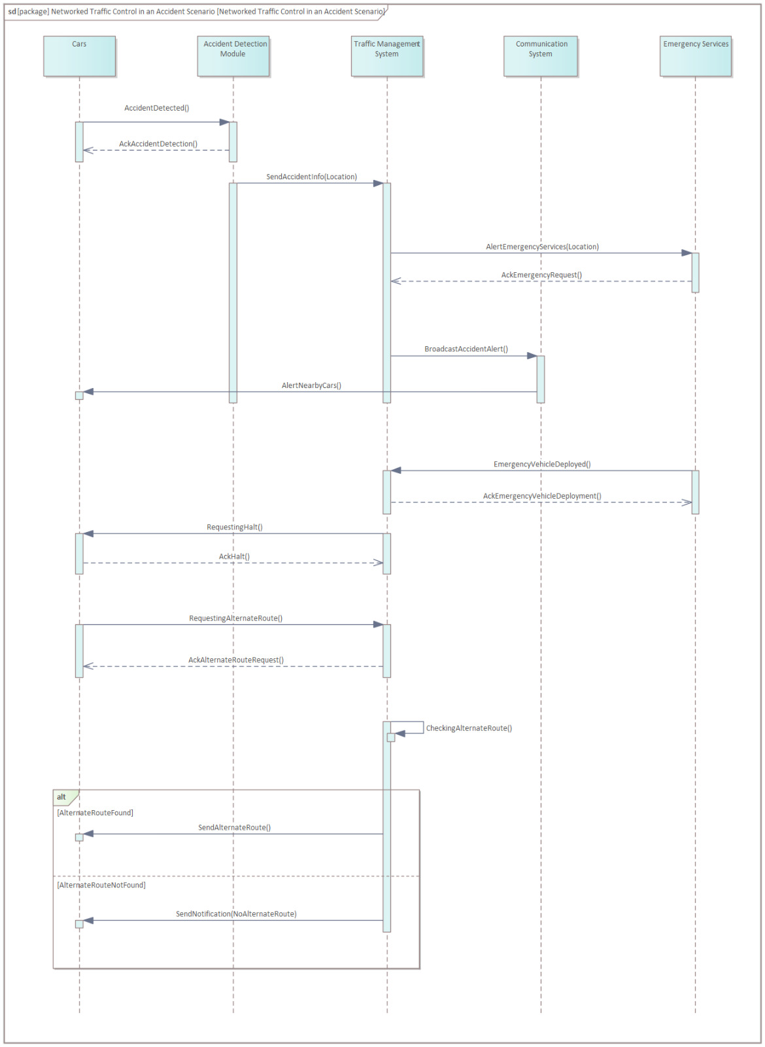
Sequence Diagram for Networked Traffic Control in an Accident Scenario

Slide 12
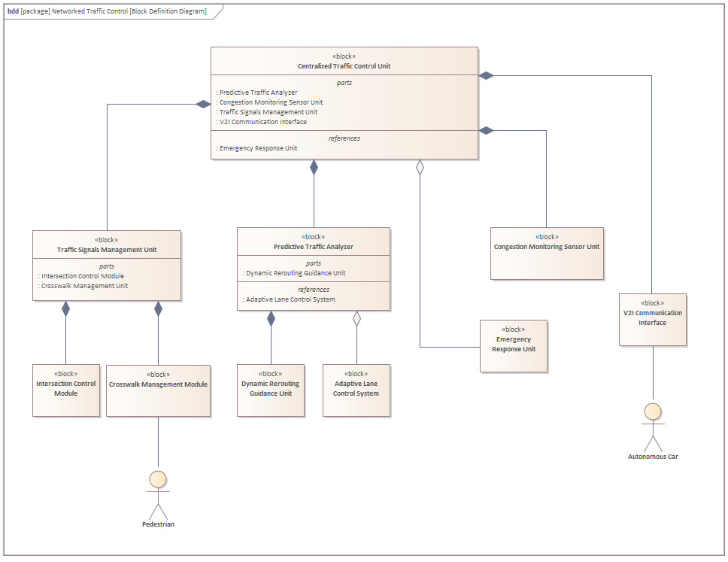
7. Block
Diagram

Slide 13
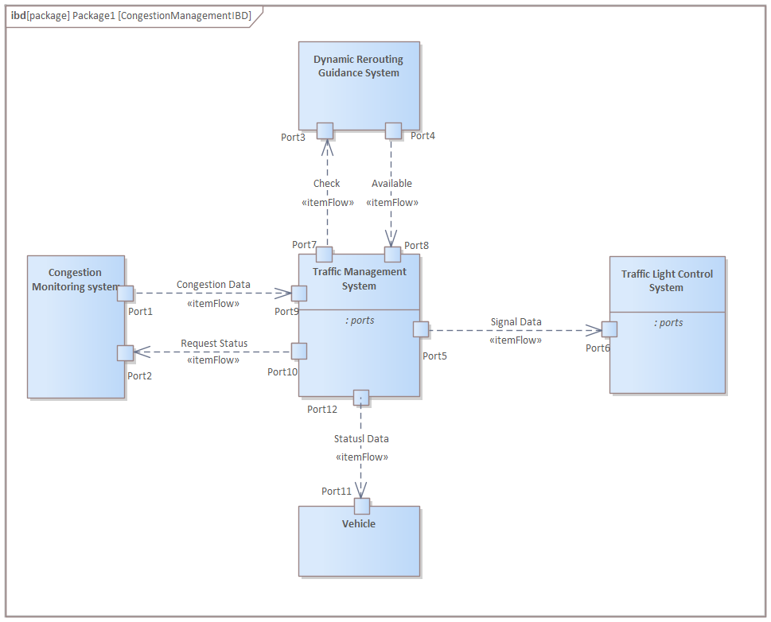
8. Internal Block Diagram

Slide 14
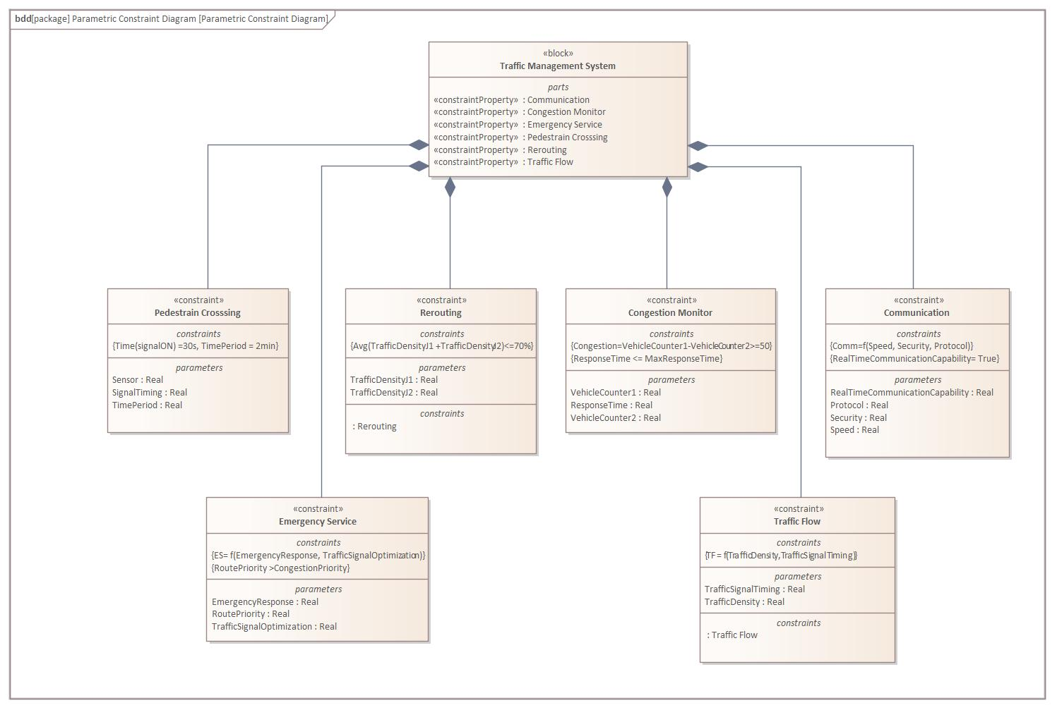
9. Parametric Constraint Diagram

Slide 15
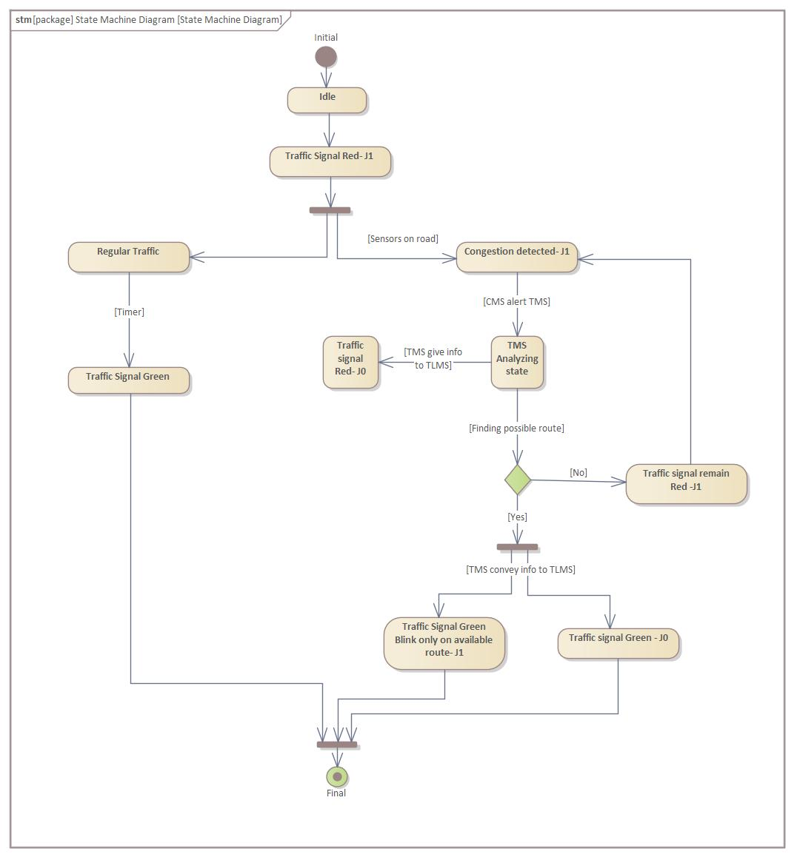
10. State Machine
Diagram

Slide 16
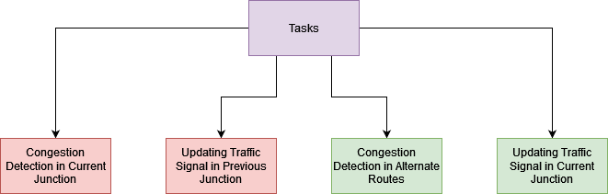
11. Task Scheduling

Slide 17
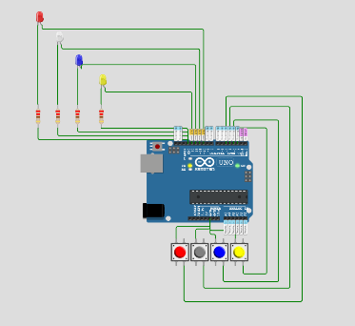
12. Implementation
Congestion in Current Junction
Congestion in Route 1
Congestion in Route 2
Congestion in Route 3

Slide 18
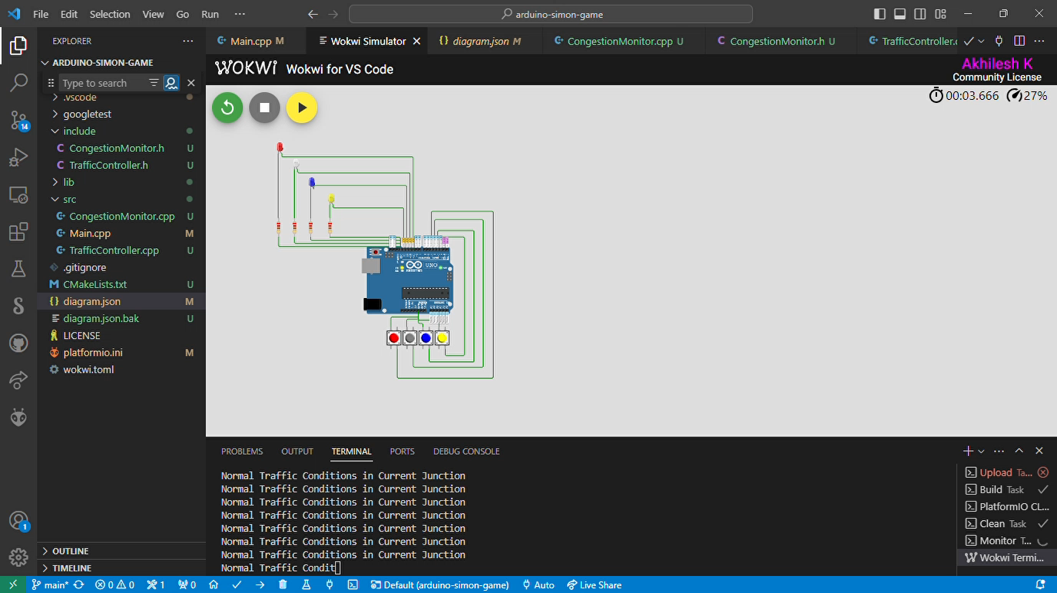

Slide 19
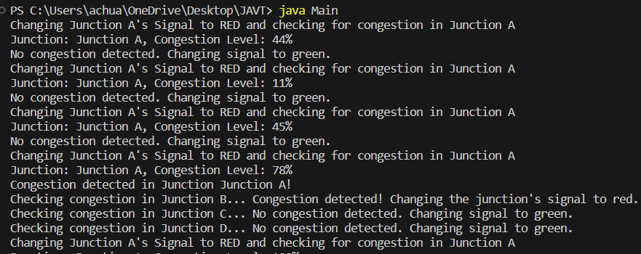
13.Testing
Output of Tested Java Code

Slide 20
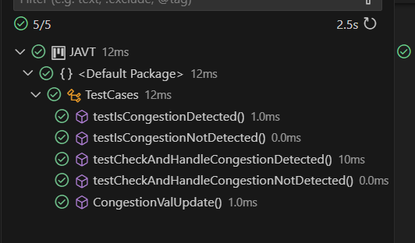
Test Case results(JUnit)
13. Testing

Slide 21
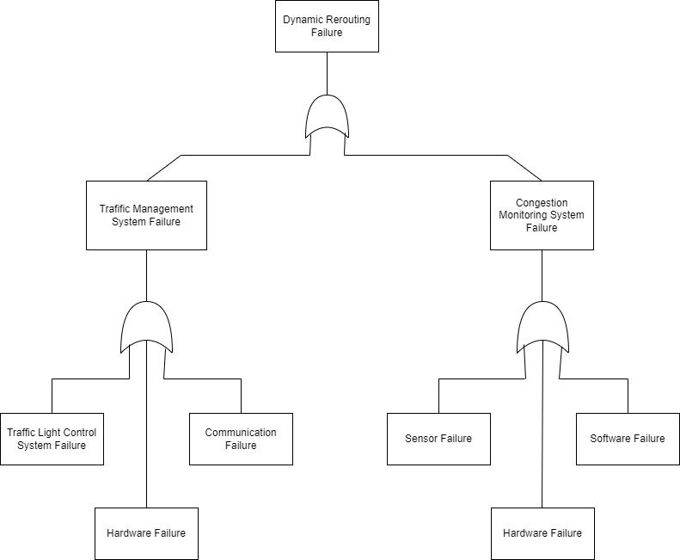
14. Hazards

Slide 22
How to overcome hazards?
Regularly monitor and test the system hardware
Redundancy and backup system
Uninterruptible power supply
Fault Tolerant System
Backup and Recovery Systems
Testing and Quality Assurance:
Error Handling and Logging:
Redundant Communication Channels

Slide 23
REFERENCE
https://sparxsystems.com/enterprise_architect_user_guide/16.0/guide_books/mbse_ea_documentation.html
https://sysml.org/tutorials/sysml-diagram-tutorial/
https://www.freertos.org/FreeRTOS-quick-start-guide.html
https://www.sciencedirect.com/science/article/pii/S2046043023000321

Slide 24
Thank you

